Slide 1
Huawei Cyber Security, Mitigating Security Risks in Digital Transformation

Slide 2
New Technologies Inject Vitality into the Digital Economy, But Also Present New Challenges for Cyber Security and Privacy Protection
New technologies
New opportunities
New challenges
Cloudification enables resource sharing and closed service platforms are opened up.
The boundaries for protection become increasingly blurred.
Cloud service
SDN/NFV
AI
AI and big data power the in-depth mining of information.
Data processing is more complex and the risk of data leaks is increasing.
Mobile networks and sensors enable high-density interconnection.
The attack surface is larger and vulnerabilities more numerous.
5G
IoT

Slide 3
Cyber Security Is Huawei's Top Priority
"Huawei views building and fully implementing an end-to-end global cyber security assurance system as a key corporate strategy. Based on compliance with the applicable laws, regulations, standards of relevant countries and regions, and by referring to the industry best practices, we work with governments, customers, and industry partners to jointly tackle the challenges of cyber security in an open and transparent manner and fully meet customers' cyber security needs. In addition, Huawei guarantees that our commitment to cyber and service security will never be outweighed by our commercial interests."
Statement on Establishing a Global Cyber Security Assurance System
"Huawei has elevated cyber security and privacy protection to our top priorities. We are committed to building trust and high quality into every ICT infrastructure product and solution we develop."
An open letter to all Huawei employees
Over the past 30 years, Huawei has served more than 3 billion people around the world and supported the stable operation of more than 1500 carrier networks in over 170 countries and regions. We have maintained a solid track record in cyber security, and our practices in cyber security have earned us the full trust of customers.

Slide 4
End-to-End Cyber Security Assurance System Covers Each Part and Person of Huawei
Huawei's top priority
GSPC
Adopt the best standards
Embedded
Legal compliance
800+ legal experts
100% employees signed BCG
Accountability system
Critical position management
Trustworthiness
US$750 million investment
Invest US$2 billion in software engineering capability improvement
Assume nothing, believe no one, and check everything
Many hands and many eyes
Strategy, governance, and control
Standards and processes
Laws/Regulations
HR
R&D
Verification
Personnel, processes, and technologies
Audit
Traceability
Issue and vulnerability remediation
Security delivery services
Manufacturing and logistics
Third-party suppliers
Internal audit
Third-party audit
Audit by customers
Software: 1h
Hardware: 4h
Product Security Incident Response Team (PSIRT)
Responsible disclosure
Three approvals
Secure remote access platform
Security work certificate
ISO 28000, C-TPAT, TAPA, etc.
Automatic testing equipment (ATE)
Digital signature
Reaching security agreements with 3855 suppliers
Supplier qualification
Incoming material test

Slide 5
Personnel: Improve Employees' Awareness and Capabilities to Avoid Risks to the Company Caused by Personal Misconduct
Organization and position management
Personnel capability improvement
Culture and climate building
100% employees have signed the Business Conduct Guidelines
500+ employees have obtained security certifications such as IAPP and CISSP.
Over 99% of all employees have received cyber security awareness training
Security KPIs set in 20+ business organizations
Integration of cyber security requirements into competency & qualification (C&Q)
Various cyber security publicity activities
Identification and management of 10+ types of high-risk positions
Training and practice of the cyber security task force
Incentives and accountability measures
Incorporate cyber security into HR policies/processes/IT systems
Every Huawei employee, both managers and new employees, participates in cyber security practices through daily work.

Slide 6
Process: Full-Process, Multi-Level, and Multi-Organization Ensure Trustworthiness and Security Implementation
Internal and external verification
Incorporate security activities into the IPD process
ICSL
Compliance test
Concept
Plan
Development
Verification
Release
Lifecycle
TR1
TR2
TR3
TR4
TR4A
TR5
TR6
GA
ICSL
Vulnerability test
Huawei's Cyber Security
Transparency center
Security requirement
Security design
Security development
Security test
Security delivery and maintenance
Independent verification
Security requirement collection
Security architecture design
Static analysis
Compliance test
Virus scanning
Security competitiveness analysis
Privacy impact assessment
Code security review
Dynamic analysis
Digital signatures of versions
UK CSEC
Independent test
Customer and
third-party test
Security compliance management
Security test design
Secure compilation
Fuzzification
Vulnerability management
Industry certification
Full process, multi-level, and multi-organization
ensures trustworthiness and security implementation
We follow the principle of "Assume Nothing, Believe No One, Check Everything".
We have established a "many hands and many eyes" cyber security verification system to ensure openness and transparency.
Customers perform independent security tests and verification through our open platform.
Ensures "No shortcut" test methods to protect customers' investment and services.

Slide 7
Introduction to ICSL: Corporate-Level Trustworthiness and Security Evaluation Center
As an independent evaluator, the Internal Cyber Security Lab (ICSL) has developed strict security redline standards and painstakingly evaluates the security of each Huawei product to be sold to customers before official release. Products that fail to pass the test cannot be released.
Verifies product compliance with security baselines and requirements
Tests products for potential security vulnerabilities
CLI
Ensures that products comply with various security compliance requirements (such as EU GDPR).
Ensures sensitive data protection and minimum authorization.
Tests web system, management and O&M security.
Verifies transmission of internal communication data is encrypted to prevent interception and tampering.
Performs code-level white-box tests on products to ensure they have no vulnerabilities.
Performs tests against external attacks such as spoofing, tampering, and information leakage.
Checks whether service logic vulnerabilities and existing CVE vulnerabilities are resolved.

Slide 8
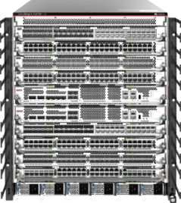
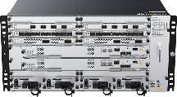
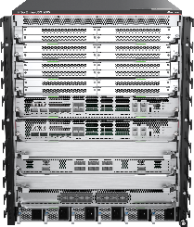
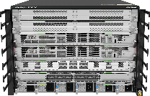
Basic Security and Trustworthiness Capabilities Underpin Stable Operation of Tens of Millions of Datacom Devices Worldwide
CloudCampus network
Huawei hyper-converged DCN
Cloud WAN
Cyber security
HiSecEngine USG6000F
CloudEngine 6860
NetEngine 8000 M8 series
CloudEngine S8700
NetEngine AR 6700
CloudEngine 16800
CloudEngine 8800
NetEngine 8000 F8
NetEngine 8000 F1A
HiSecEngine USG12000-F security gateway
Software platform
Centralized
Distributed
Single-process and single-core
Multi-process and multi-core
V1
V3
V5
V8
1994
2022
27+
12 million+
11,000+
years of R&D accumulation
core devices
R&D personnel

Slide 9
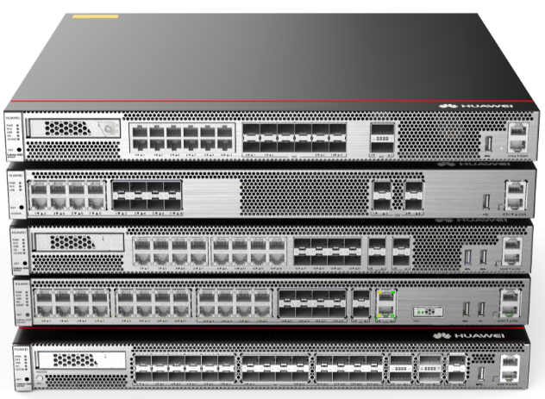
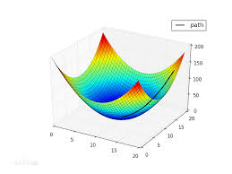
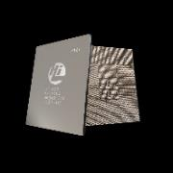
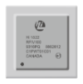
20 Years of In-depth Security Development: Huawei Builds Full-Stack, Independent, and Controllable AI + Cyber Security Capabilities
Global talent distribution
Full-stack independence and controllability
AI-based precise detection
Perlis Lab
Germany Lab
Devices
Federated learning
Threat detection rate
Automatic evaluation tool
Intelligent analysis and detection algorithm
Dynamic analysis of malware
Big data security
APT products
AI firewalls
IPS/Anti-DDoS products
J(17,18)=90
J(18,19.5)=175
97%
J(14,7)=1
85%
Beijing Lab
Canada Lab
Big data-based security algorithm
Security services and emergency response
Research on core technologies of network protection
Static analysis of malware
System software/platforms
b
Competitor A
Huawei
w
YunShan platform
EulerOS
Big data platform
Online and offline federated learning ensures the threat detection accuracy of 97%.
The threat detection rate is 12% higher than that of competitor A outside China.
The model optimization time is shortened from 60 days to 6 days, greatly improving the threat information production efficiency.
Security R&D team employees: 2500+
Investment in 2020: CNY10 billion+
Additional investment in trustworthiness in the next five years: CNY12 billion
Basic chips
Industry's only high performance
secure SoC processor
Server management and control
series chips

Slide 10
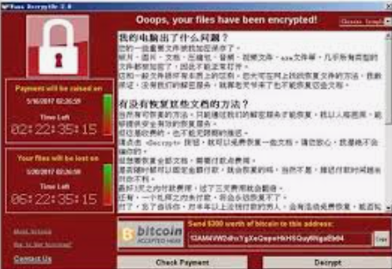
Innovative Anti-ransomware Solution Provides Network + Storage Full Protection
Network Interception
Production Environment
Backup Environment
Extranet
Network product implementation
Production network
Backup network
Sandbox
Firewall
Production hosts
Detection
Detection
Situational awareness
Switch
Anti-tamper
SAN/NAS
Anti-tamper
Anti-tamper
Anti-tamper
AIR GAP
Terminal
E
E
E
Isolation zone storage
Production storage
Backup storage
AIR GAP
Backup storage
Isolation zone
Isolation zone
Protection layer 1:
network detection
Protection layer 2:
production protection
Protection layer 3:
backup protection
Firewall Intrusion detection to filter known ransomware
Sandbox for in-depth analysis to identify unknown ransomware
Combined with the situational awareness platform to block horizontal ransomware spread

Slide 11
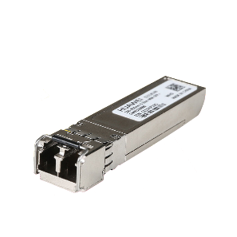
Core Components, Independent and Controllable Key Technologies Build a Complete and Resilient Supply Chain
Forwarding
Computing
RF module
Optical module
Software
HiSilicon series chips are applied to multiple products including routers, switches, and security gateways.
Provides open programmability.
HiSilicon CPU provides high-performance computing capabilities for network devices.
HiSilicon series chip, which provides high-speed and stable wireless air interface connections.
Powered by 5G technologies.
HiSilicon interface chip.
Full series of optical modules from GE and 10GE to 100GE, 200GE, and 400GE.
Datacom YunShan OS.
EulerOS, and GaussDB.
Huawei-developed controller and analyzer.
100% of core components are self-developed and supplied

Slide 12
Nearly 100 Million Huawei Datacom Products Have Been Running Stably, Securely, and Reliably in 100+ Countries
Government
Finance
Education
ISP
Energy
Transportation
1160+
1120+
1180+
2200+
320+
380+
60+
6
32
100+
230,000
17
National government broadband network
of top 10 banks
of QS top 100 universities
Countries
of top 20 oil and gas fields
Highway/Railway (km)
1100+
new global enterprise customers in 2021, serving 267 Fortune Global 500 companies

