Slide 1
Delivering security for Government in a Zero Trust Digital World
Ndumiso Khoza

Slide 2
Data and Security Breaches
“TikTok facing increased security scrutiny after reports of data breach” - September 2022
“US court system hit by big cyberattack” - July 2022
Personal information of millions of South Africans exposed in banking data breach” - August 2020
“Credit bureau data disaster: Fraudster has details of many South Africans, banks issue warnings” - August 2020
Notes:
I am sure many of you are aware of some the headlines in the news and media about major data and security breaches that have affected a number of major organisations both locally and internationally.
With the pandemic accelerating the pace of digital transformation of business, government and social interactions, what’s become clear is that unfortunately security isn’t getting easier.
This recent high-profile data and security breach activity has underscored the growing sophistication of today’s threats and the complexity of managing business risk in an increasingly connected and digital world

Slide 3
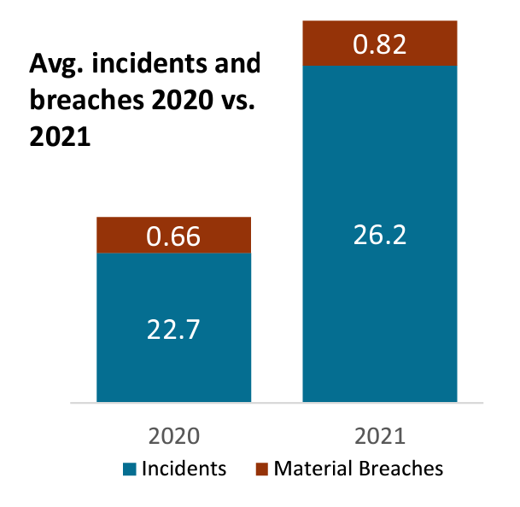
The average number of attacks and breaches rose sharply in 2021 - the number of incidents rose 15.1%, while the number of material breaches jumped 24.5%
ThoughtLab 2022
Notes:
A study of 1,200 worldwide organizations across 14 industries revealed that cybersecurity is at a major turning point -

Slide 4
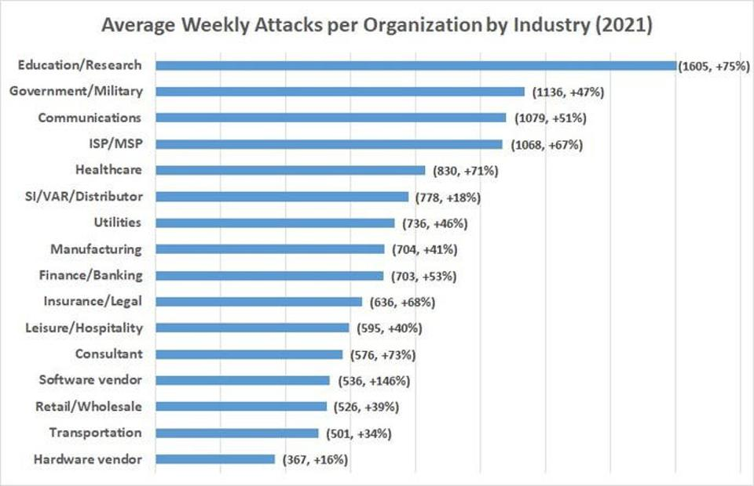
Cyber Attacks by Industry 2021
Check Point Research 2021
Notes:
Another study on cyber attacks in 2021 reveale that
The education/research sector sustained the most attacks in 2021, followed by government/military and communications.

Slide 5
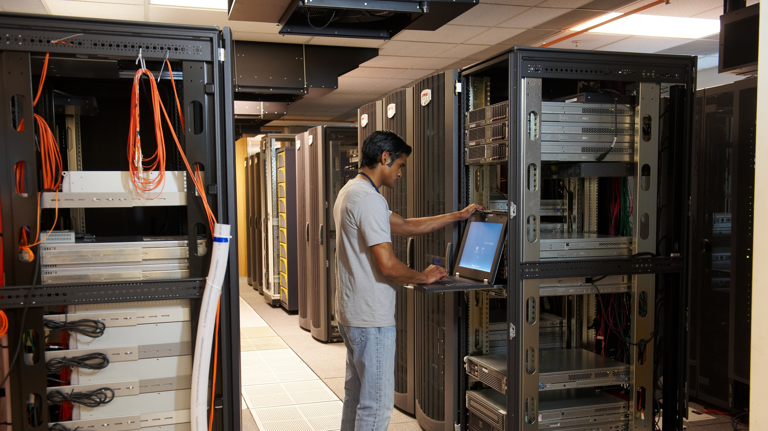
Cybersecurity in a digital world
Microsoft Confidential – Internal Use Only
Everything goes digital
Work becomes riskier
Platform & ecosystem play
Physical & digital worlds collide
New technologies emerge
Notes:
We have seen attacks grow significantly during the pandemic with accelerated digital transformation and increased remote working contributing to this growth.
Working from home also created new security challenges for may organisations who need to make sure that their employee's data is safe when they are home
As the platform economy takes shape and ecosystems replace organisations: This Digitizing of old business processes fosters the use of more connections which leads to hackers exploiting these new digital services
Digitally connected physical assets expose strategic infrastructure to greater attack. The protection of cyber-physical systems will be the biggest challenge over the next two years
The grown of AI, IoT and 5G technologies create cyber vulnerabilities for organizations to manage and provide even more advanced weapons for criminals

Slide 6
Principles of Zero Trust
Instead of assuming everything behind the corporate firewall is safe, Zero Trust assumes an open environment where trust must be validated.
Assume breach – Assume that attackers will succeed (partially or fully) and design accordingly
Verify explicitly – Validate trust of users, devices, applications, and more using data/telemetry
Use least privileged access – to limit the impact of any given compromise
Microsoft is actively working with NIST, The Open Group, CISA, and many others across industry to harmonize definitions, model, and architectures for Zero Trust
Notes:
Instead of assuming everything behind the corporate firewall is safe, the Zero Trust model assumes every request is a potential breach. As such, every request must be verified as though it originates from an open network. Regardless of where the request originates or what resource it accesses, Zero Trust teaches us to “never trust, always verify.” Every access request is fully authenticated, authorized, and encrypted before granting access. Microsegmentation and least privileged access principles are applied to minimize lateral movement. Rich intelligence and analytics are used to detect and respond to anomalies in real time.
The underlying principles that provide the foundation of the Zero Trust model include:
Assume breach. Verify all sessions are encrypted from start to finish. Use analytics to get visibility and drive threat detection and improve defenses
Verify explicitly. Always authenticate and authorize based on all available data points, including user identity, location, device health, service or workload, data classification, and anomalies.
Use least privileged access. Limit user access and data protection to help secure both data and productivity.

Slide 7
Zero Trust Approach from Microsoft
Identities
Applications
Continuous risk assessment & Automation
Threat intelligence & Telemetry
Data
Zero Trust policy enforcement
Infrastructure
Endpoints
Network
Notes:
The Zero Trust model consists of the following primary components:
Identities. Verify and secure each identity with strong authentication across your entire digital estate.
Devices. Gain visibility into devices accessing the network. Ensure compliance and health status before granting access.
Applications. Discover shadow IT applications, ensure appropriate in-app permissions and gate access based on real-time analytics, and monitor and control user actions.
Data. Move from perimeter-based data protection to data-driven protection. Use intelligence to classify and label data. Encrypt and restrict access based on organizational policies.
Infrastructure. Use telemetry to detect attacks and anomalies, automatically block and flag risky behavior, and employ least privilege access principles.
Network. Ensure devices and users are not trusted just because they are on an internal network. Encrypt all internal communications, limit access by policy, and employ microsegmentation and real-time threat detection.
Additional reading. For more information on Zero Trust security, see the Zero Trust maturity model.

Slide 8
Why secure the hybrid workforce
Why secure the hybrid workforce
Provide remote access Enable remote workers to securely access the apps they need from anywhere.
Secure devices and apps Enable BYOD and unify management and security across devices and apps.
Protect corporate resources Empower IT to apply controls and protect endpoints without getting in the way of productivity.
81%
of business leaders find that staying ahead of attackers is a constant battle.
Source: State of Cybersecurity Report, Accenture, 2021.
Notes:
Source: https://www.accenture.com/_acnmedia/PDF-165/Accenture-State-Of-Cybersecurity-2021.pdf

Slide 9
Thank you
Q & A

