Slide 1
DPSA commentary on SSA Cyber Security Framework – Zaid Aboobaker
Department of Public Service and Administration (DPSA)

Slide 2

56%
97

Slide 3
DPSA Directive VS SSA Cyber security Framework
What are these documents?
DPSA Directive: A mandatory directive from the African Department of Public Service and Administration, setting out information security governance, practices, and procedures.
CRMF: A voluntary guidance framework for cyber risk management, providing an approach and tools.
What's their shared goal?
To protect information and technology assets and ensure the confidentiality, integrity, and availability (CIA) of information and systems.
Key Shared Areas of Focus:
Risk Management: Both address the management of ICT-related business risk.
Physical Security: Includes physical protection of assets and environments.
Human Resources Security & Awareness: Emphasize HR security operations and security awareness training.
Network & Cloud Security: Cover securing network infrastructure and cloud environments.
Incident Response & Business Continuity: Address ICT service continuity, disaster recovery, and incident management.
Third-Party Management: Acknowledge the importance of securing third-party access and service providers

Slide 4
Public Service Information Security - Key Differences
Authority & Compliance - Legally binding VS Voluntary guidance
Level of Detail & Purpose: High-level mandatory requirements VS Detailed, five-step methodology with "hundreds of controls structured across 32 cybersecurity domain categories
Structural Approach – Aligned to the broad ISO areas vs providing a 5 step approach
Threat & Impact Analysis:
DPSA Directive: Focuses on internal controls without detailed threat actor analysis.
CRMF: Includes a dedicated "Cyber Attack and Defence Landscape" section detailing motivations of both external (e.g., Nation-States, Organized Crime) and internal (e.g., Former Employees, Unauthorised Users) threat actors. Also details impact categories for incidents (financial, people, reputational, legal).
Control Assessment Methodology:
DPSA Directive: Mentions auditing and monitoring but lacks a specific assessment methodology.
CRMF: Provides a detailed four-step cybersecurity assessment process (scope, team, assess, analyze risk), including rapid assessment sheets with Confidence Scoring and Customer Level of Urgency Scoring for controls.

Slide 5
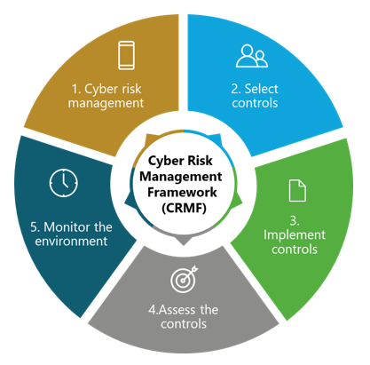
Enhancements
Hybrid approach to risk Common risk( SSA- DPSA) vs LOB risk (Department – Cluster)
Continuous review of risk identification
Integration into existing mature processes
Identify a minimum set of controls
Consider centralizing controls in OTP’s and or SITA e.g. Infrastructure controls
Central DISO office for provinces
SITA or industry-standardized cyber sec offerings
DISO in a box
Move to shared infrastructure
Standard tools
Develop SOP’s and provide tools to departments
Multi-Layered monitoring approach
Department Sec Steerco
Dept Security officer (DISO)
SSA
DPSA Compliance monitoring
Central control approval mechanism DPSA – SSA-SITA
Auditor General

