Slide 1
State Security Agency GovTech 2025

Slide 2
Presentation Overview
Mandate
SSA Role on Information / Cybersecurity
ICT Risk and Assurance Services
Monitoring Service
Common Challenges Identified within Organs of State
Cybersecurity Risk Management Framework
Questions

Slide 3
Mandate
The General Intelligence Laws Amendment Act, section 2(e) (i) of Act 11 of 2003, provides that State Security Agency must protect and secure critical electronic communications of all organs of state against unauthorized access of technical, electronic or any other related threats
National Communications which is a branch of State Security Agency which deal with ICT Security, was then mandated to perform the above mandate.
Objective: To protect state information and secure critical electronic communications of Organs of State

Slide 4
SSA: ICT SECURITY SERVICE CATALOGUE
Service (1) : ICT Security Risk and Assurance Services
SERVICE ELEMENT | DESCRIPTION
Regular ICT Security Risk Assessments | Determine security needs of the OoS Determine ICT Security Posture of OoS Monitor progress in the implementation of the security controls
ICT Security Governance | Develop ICT security standards and regulations Review of the ICT Security Policies, Standards, Processes and procedures.

Slide 5
SSA: ICT SECURITY SERVICE CATALOGUE
Service (1) Name: ICT Security Risk and Assurance Services
SERVICE ELEMENT | DESCRIPTION
Advisory Services | ICT & Cyber Security Awareness Presentations & Advisory Evaluate compliance with security standards and regulations

Slide 6
SSA: ICT SECURITY SERVICE CATALOGUE
Service (2) : ICT Security Monitoring Services
SERVICE ELEMENT | DESCRIPTION
Proactive Cybersecurity Services | Technology watch (Technology News, Security Updates, Cyber Crime and Intelligence in the News) Alerts and Warnings Technical Vulnerability Assessment and Penetration Testing Monitoring (Incident Management) Cyber Threat Intelligence

Slide 7
ICT SECURITY SERVICE CATALOGUE
Service (2) : ICT Security Monitoring Centre (CSIRT Service)
SERVICE ELEMENT | DESCRIPTION
Reactive Cybersecurity Services | Incidents Response Digital Forensics Cyber Threat Hunt

Slide 8
COMMON CHALLENGES IDENTIFIED
Policy implementation, compliance enforcement and security awareness
Outdated policies and procedure
Selective enforcement
Lack of security awareness
Security awareness only focused on policy
Sanctions for non-compliance not implemented

Slide 9
COMMON CHALLENGES IDENTIFIED
2. Security Oversight
Non Functional Steering Committees
Not sitting as regularly as they should
Poor participation from business
Security issues and breaches not addressed
3. Information Asset Disposal
Lack of disposal policy and procedure
Disposal managed by asset management without recommendations or inputs from ICT department
Lack of classification of assets

Slide 10
COMMON CHALLENGES IDENTIFIED
4. Poor Security Hygiene
Inadequate security design standards - Next-Gen firewalls & Proxies not implemented
Lack of effective email security (for malware and Phishing attacks)
Use of unlicensed software
Lack of advanced endpoint security measures (EDR or XDR)
No preservation of syslog messages (required for investigation of incidents – minimum 6 months for dwell time)

Slide 11
COMMON CHALLENGES IDENTIFIED
5. Patch Management & Hardening
Outdated and unsupported Operating Systems and Applications
Lack of patch management strategy or procedure
Patches not tested before deployment
Firewall rules not reviewed for optimisation
Unused software left not uninstalled
Unused ports not closed

Slide 12
COMMON CHALLENGES IDENTIFIED
6. Incident Management
Proactive ICT security monitoring not conducted
No consideration of major cyber events or attacks
No procedure for preservation of evidence
No defined chain of command
Slow implementation of recommended controls

Slide 13
COMMON CHALLENGES IDENTIFIED
7. Business Continuity Management
Lack Of BIA and Risk Management
Lack of backup facilities and strategy for data
Lack of disaster recovery facilities
Backups not tested
BCP and DRP not tested

Slide 14
Cyber-Risk Management Framework
The Framework consists of the following key assets:
Cyber Risk Management Framework.
32 Cybersecurity Domains.
32 Cybersecurity Policies Templates.
Guidance to select and implement controls for all the 32 domains.
A rapid cybersecurity risk assessment sheet.
The Framework, policies and standards are based primarily on the following international standards and best practice guidelines:
NIST (Cyber Security Framework)
ISO 27001 ISMS (Information Security Management System)
ISO 27002 (Information Security Controls)
CIS (Critical Security Controls)
ISO 27701 PIMS (Privacy Information Management System)

Slide 15
Cybersecurity Implementation Standard
The standards referred to herein, are not technical standard but mainly statements that describe what must be implemented to achieve the security objectives of the organization in a uniformed and standard approach.
The 32 Cybersecurity domains are separated into two portfolios, Organizational section which consist of 10 domains and the Operational/Technical section with 22 domains.

Slide 16
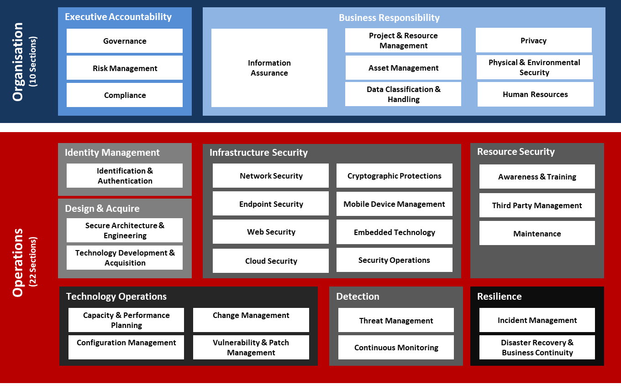
IMPLEMENTATION STANDARDS - DOMAINS

Slide 17
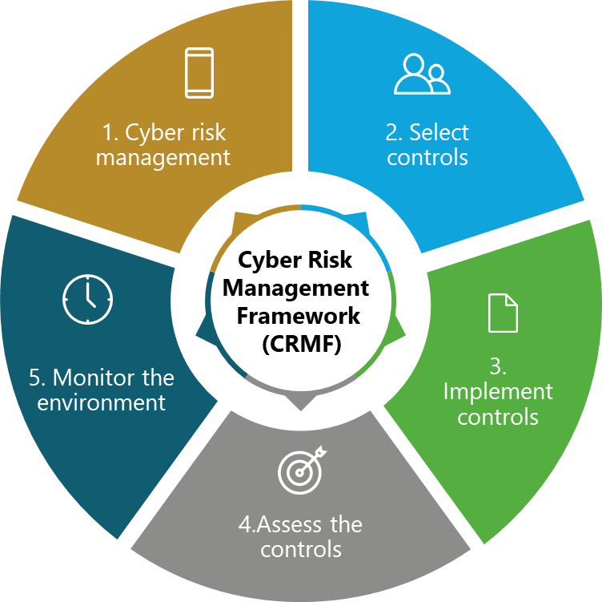
Cyber-Risk Management Framework
Figure 1. Key Steps to Implement the Cyber Risk Management Framework (CRMF)

Slide 18
STEP 1: Cyber Risk Management
Purpose
This step aims to carry out essential organisational activities such as understanding the organisation's context, aligning cyber risk to the enterprise risk management methodology and understanding the potential impact on critical crown jewel assets. This important step is to help prepare the organisation to manage its security and privacy risks using the Cyber Risk Management Framework.
Outcomes:
key risk management roles identified (e.g. LACK OF CHANGE MANAGEMENT CONTROLS)
organisational risk management strategy established, risk tolerance determined
organisation-wide risk assessment
organisation-wide strategy for continuous monitoring developed and implemented

Slide 19
STEP 2: Select Cybersecurity Controls
Purpose
This step aims to select, enhance, and document the controls necessary to protect the organisation and information systems commensurate with the risk to organisational operations, assets, individuals, critical information infrastructure, and the country.
Outcomes:
Control baselines selected and tailored
Controls allocated to specific risk requirements
Security and privacy plans that reflect the control selection and allocation are reviewed and approved

Slide 20
Step 3: Implement Cybersecurity Controls
Purpose
To implement the controls in the security and privacy plans for the system and the organisation and to document the specific details of the control implementation in a baseline configuration.
Outcomes:
Controls specified in security and privacy plans implemented
Security and privacy plans updated to reflect controls as implemented

Slide 21
Step 4: Assess Cybersecurity Controls
Purpose
The Assess step aims to ensure relevant controls are implemented correctly, operating as intended, and producing the desired outcome of meeting the security and privacy requirements for the system and the organisation.
Outcomes:
Assessor/assessment team selected
Assessment plans are developed, reviewed and approved
Control assessments are conducted per assessment plans
Security and privacy assessment reports are developed
Remediation actions to address deficiencies in controls are developed
Plan of action and milestones developed

Slide 22
Step 5: Monitor the Environment
Purpose
The purpose is to monitor the ongoing situational awareness of the security and privacy posture of the organisation in support of cyber risk management decisions.
Outcomes:
Monitoring implemented controls based on organisational business and risk requirements
Ongoing assessments of control effectiveness conducted at agreed intervals.
Processes in place to report security and privacy posture to management
Ongoing authorisations conducted using results of continuous monitoring activities.

Slide 23
Benefits and Challenges
Benefits for a successful implementation:
Established maturity baseline security controls for all Organ of State.
Ability to identify cyber risks and mitigate threats.
Reduced duplication and project costs.
Reduced costs of security incidents.
Challenges for a successful implementation:
Continuous monitoring and review to ensure efficacy of the CRMF.
Comprehensive and regular Risk Assessment.
Self assessment
Skills shortage and capacity building.
Lack of penalties for non-compliance.

Slide 24
End of the Presentation
Thank You

